Slide 1
Factors influencing and maintaining youth gang membership.
Sarah Campbell

Slide 2
Outline
Definitions of “Youth gangs”
Some relevant statistics
Methodology
Exploring the results
Relevance to the existing literature
Adaptation of an existing model
Further implications and research

Slide 3
Definitions
Thrasher (1927/1963)
Informal structures
Relationship between members
Evidence of organisation
Nomadic tendencies & engage in conflict
Common tradition/culture
Ownership of a defined space which requires defending.
Curry & Decker (1998)
A social group
Using common identifiers
Specific communication styles to demonstrate gang connections
Evidence of some permanence
Identification of territory
Association with criminal activity.
Notes:
The term ‘youth gang’ has been used by nearly everybody for numerous different purposes.
Compared with adult gangs, there is a tendency to suggest that youth gangs are more fluid and less organised.
Further complicating this issue is that teenage populations in general participate in similar activities like antisocial behaviour, drug use, sexual promiscuity and violence.
Thrasher did not emphasise criminal offending as a common behaviour, however other researchers have since included this.
Further research has also suggested that self-nomination was an equally reliable measure of youth gang membership.
It was Curry & Decker’s definition that was used to inform the critieria for participants in this study

Slide 4
Statistics
Prevalence of youth gang population unknown
Est. 600 youth gang members in South Auckland
(Ministry of Social Development, 2006)
HAMILTON
Est. 27 different youth gangs in Hamilton (Paki, 2008)
Unemployment
Education
Annual income
6.8% of general population & 16.6% of Māori population
22.2% <15 years have no formal education
33.8% Māori <15 have no formal education
$24,000 for individuals <15
$20,600 for Māori <15
Notes:
Despite this, media have a tendency to report that youth gang activity has increased locally and nationally
These 600 members were thought to affiliate with 73 different gangs
Important to recognise that geographical locations may mean different experiences for residents

Slide 5
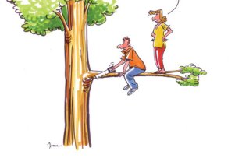
Methodology
Recruitment:
Alternative education providers
Community agencies
The 7 Youth in this study were:
Male residing in Hamilton City region
Aged between 16-23 years
Self nominated youth gang members
All identified as Māori
First entered into an official gang between 9-13years
3 were unemployed; 4 were enrolled in alternative education
Are you sure we have the right methodology?
Notes:
Teachers, community constables, school counsellors and community youth workers were all approached to recommend young people for this study.
Some participants further asked their fellow youth gang members to participate.
They were given a twenty dollar voucher after the interview.

Slide 6
Thematic Analysis
Semi-structured interviews lasting approx. 60mins
Focus on:
first time gang involvement
current gang involvement
Demographics
Thematic Data Analysis (Braun & Clarke, 2006)
Become familiar with the data
Generate initial codes
Search for themes
Review the themes
Define the themes

Slide 7
Results
Reasons for youth gang membership
Antisocial behaviour
Influence of friends
Neighbourhood Surroundings
Negative Evaluation from others
Access to money

Slide 8
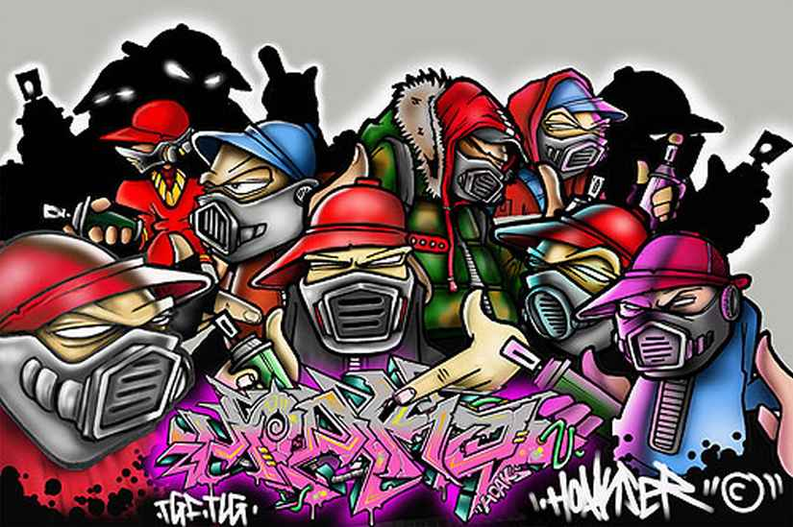
Influence of Friends
The “Cool” Group
“Thought it looked cool being a gangster so you just get into it”
Substitute Family
“They see these gangs and they think these bros are mean and they treat them good and everything like that… better than their own family so they kind of adopt them as a new family”
Providers
“Chicks, money, weed, drugs, power…respect! That kind of stuff, just from their people”
Notes:
Friends served a number of different functions within the gang:
Firstly, participants experienced a greater degree of notoriety when accepted into the cool group or gang
They also became a part of a family unit that supported them to a greater degree than their existing families
Many explained that their male relatives were involved with gangs which they thought was cool
At the same time, these young people were longing for acceptance into a group because their role models were occupied in the gang
This support included the provision of financial, physical and emotional support in times of need
The influence of friends in promoting an antisocial lifestyle is readily discussed in the literature
Less frequently acknowledged is the role that youth gang members have in accepting and nurturing young people who have often been rejected by society and their families.

Slide 9
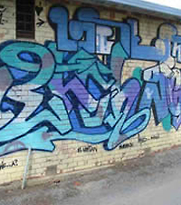
Antisocial Behaviour
Violence
“I know that it might sound horrific, but the real reason that I wanted to jump in a gang is that I wanted to inflict pain on people. Cos people, like I have been abused, & people inflicted pain on me so I wanted to give back”
Drugs
“I was already into drugs beforehand so it was just like a bonus…that would be a thing that would make you want to join a bit more”.
Notes:
Participants focused a lot on their participation in antisocial behaviours
By participating in violence and selling or using drugs, they perceived that it increased the respect that they gained from others in gang and likeminded peers.
This meant that they had privileges and could tell others what to do from as young as 9 years of age.
Some participants explained that they were so angry and fighting was just one way rid themselves of this emotion.
Others described violence as being fun as they were just angry people.
Many of these participants therefore described their environments outside of the gang as unpredictable and untrustworthy.
Friends in the gang were therefore necessary to defend and support them.
The greater availability of drugs was also a key reason to join the gang.
Many had experimented with drugs from as young as 8 years as it was easier to get than alcohol.
As they became increasingly affiliated with the gang, they would skip school and use drugs or acquire money to buy drugs on a regular basis.
Participants then described feeling pressure to experiment with other substances with their mates

Slide 10
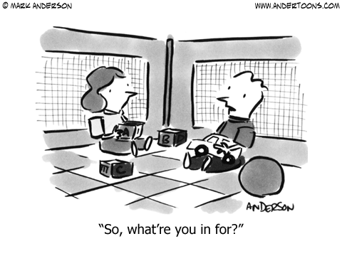
Prison
“Every jail is a school for gangs. That’s where they study”
“Jail doesn’t even help cos then you are just meeting up with even more criminals and then its teaching you…you learn more things, more criminal things… makes you smarter”
Notes:
For many, they had to face the legal consequences of their antisocial behaviour. For those that went to prison, they said they had to affiliate with a gang to survive their sentence. This required an involvement in antisocial behaviours to get the respect and power amongst other inmates.
Furthermore, participants explained that any skills and knowledge they had from the community would be enhanced in jail.

Slide 11
Access to Money
No Qualifications
“That’s not going to make you money [staying at school]…the way to make money is… ya know…faster. I get money when I want money, ya know, at school, you just sit around…don’t really learn much”
Self-sufficient
“I don’t wan to live on the DOLE for the rest of my life. Have nothing, nothing to look at, nothing to live for, nothing to show for”
Notes:
Due to their parents financial situation, many participants described needing to earn money in the easiest possible way from a young age.
This included selling drugs or stolen goods.
The advantage of joining a gang was that they had a well established system to make money quickly
Remaining at school would therefore have been detrimental to the business opportunities in the gang.
Many actually described themselves as businessmen, particularly as professionalism was important to ensure longevity of their business.
As many of these individuals had left school and were living independently within the gang, they needed to be self sufficient to ensure they could afford their chosen lifestyle.

Slide 12
Neighbourhood Surroundings
Normalised
“Yip…that’s where the gangsters were [in the neighbourhood]. It’s the thing…its good to have mates that look after you and are always there for you”
Territory
“Yup…we have our streets that we take care of. Neighbourhoods…towns…You have to be pretty dedicated to do it”
Notes:
Many explained that their neighbourhoods socialised them to youth gang membership.
They described it as normal development – something that was expected.
Having friends in the gang who were in close proximity were also important as they were easily accessible in instances of threat or attack from others.
The sense of ownership that they had over their given area further maintained their desire to remain in the gang.
Being perceived as staunch or tough further increased their noteriety.

Slide 13
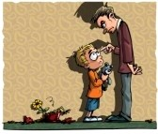
Negative Evaluation from Others
School
“I just never liked the teachers. They always just used to judge me before they knew me. I thought that they thought that Māori boys couldn’t make it nowhere”
“Oh I just don’t like being told what to do!”
Society
“If you think that I am going to be a bad arse, I am going to prove it. I am going to be the baddest cunt ever”
Notes:
Not one of these participants described their schooling as enjoyable.
Many felt as though they were negatively judged by teaching staff based on their race and family backgrounds
This impacted on their desire to apply themselves in the classroom
Many also hated being told what to do at school, particularly because within the gang they had the freedom to make their own choices.
Participants also disliked being stereotyped by mainstream society. This included being perceived as violent, lazy, a thief or dishonest. In response to these stereotypes, participants said that they would go out of their way to conform to these expectations.. And that is exemplified by the above quotation.

Slide 14
An adapted model
Macrosystem
Negative stereotypes; Racism; General education system
Microsystem
Male cousins; Fathers; Friends; Teachers.
Exosystem
Neighbourhood; Punishment strategies
Mesosystem
School system; Extended family
Ecological Model of Development (Bronfenbrenner, 1979)
Notes:
The purpose of Bronfenbrenner’s Ecological Theory of development was to consider how an individual develops within the different systems of their environment.
The microsystem contains the developing individual and the direct interactions they have with people or objects in their environments.
At this level, the most influential people were fathers, uncles, cousins, and friends who were in gangs
Because of these relationships, young people were also looking for belonging
The relationships they had with teachers was also weak
The mesosystem is defined as the interrelations in several different settings which the individual frequently participates
Many of these young people explained that in each of these different settings, they were socialised to drug use, antisocial behaviour, and means to acquire money illegally.
Solve problems with violence which also gives them respect and power
The exosystem is the variety of settings which are not directly occupied by the developing person, but that the events within this system impact on the individual.
Lack of financial support from parents and family which increased the desire to make money in the gang
Easy to find a group of similar young people in their neighbourhoods
This strengthened the bond in the gang
Going to prison was strengthened the bond between gang members.
The final system was the macrosystem. All previous systems are encompassed within this wider system as well as the consideration of subcultures and cultures.
This included racism within the school system
The lack of attachment to the education providers meant it was increasingly hard to compete against the lifestyle within the gang
These stereotypes were noticed more generally by participants.

Slide 15
Things to consider
Provide support to young people from a young age
Provide an opportunity to earn an income
Facilitating sense of belonging
Increase positive male role models
Facilitate well informed choices for the future
Experience adrenaline and risk
Interesting subjects that lead to jobs
Schools facilitate re-connection with culture
Notes:
The consistencies in research over the past 10 years would suggest that:
the needs of young people have remained the same
the alternative to youth gang membership that have been proposed are not reaching some people or are not substantial enough to prompt the individual to join.

Slide 16
References
Bronfenbrenner, U. (1979). The ecology of human development: Experiments by nature and design. Cambridge: Harvard University Press.
Curry, G.D., & Decker, S.H. (1998). Confronting gangs: Crime and community. Los Angeles, CA: Roxbury.
Egglestion, E. (2000). New Zealand youth gangs: Key findings and recommendations from an urban ethnography. Social Policy Journal of New Zealand, 14, 148-163.
Ministry of Social Development. (2006). From wannabes to youth offenders: Youth gangs in Counties Manakau. Wellington: Ministry of Social Development.
Thrasher, F.M. (1927). The gang. Chicago: University of Chicago Press.

